Slide 1
Microsoft 365 & Power Platform Development – Bi-weekly call
Your host in this call: David Warner (Microsoft)
June 9th, 2022

Slide 2





v
Agenda
Latest on PnP Framework and Core SDK extension
Latest on PnP PowerShell
Latest on yo Teams
Latest on Microsoft Graph Toolkit
Independent Publisher Connectors
Latest on script samples
Latest Microsoft Teams samples
Latest on Power Platform samples
Picture time with the Together Mode!
Nanddeep Nachan & Smita Nachan - Independent Publishing Connectors Sessionize Demo
André Lage - List Formatting - Payment Registration
Paolo Pialorsi - Understanding Sites.Selected permissions in SharePoint Online

Slide 3
Opportunities to Participate in the community
Demo solution or technical pattern
Contribute on GitHub
Provide feedback
Great opportunity to get visibility for you or your company. Demo sample or explain how you extend or customize SharePoint Online with live demo in your projects. Reach out to team for volunteering.
Request a demo spot on the call
https://aka.ms/m365pnp/request/demo

Slide 4
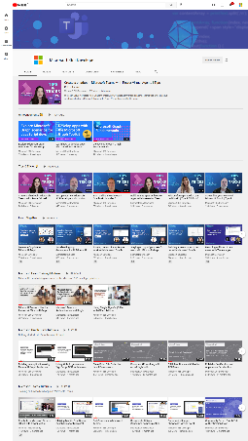
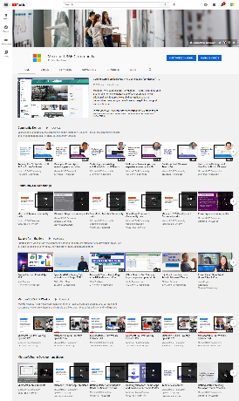
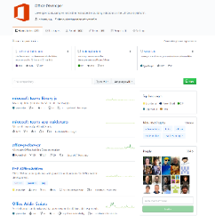
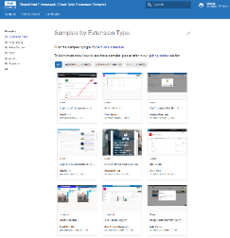
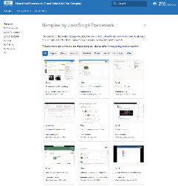
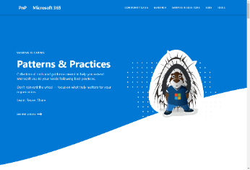
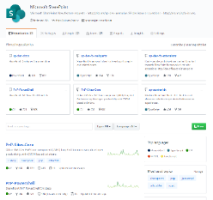
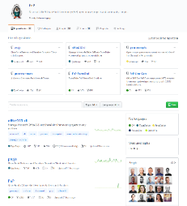
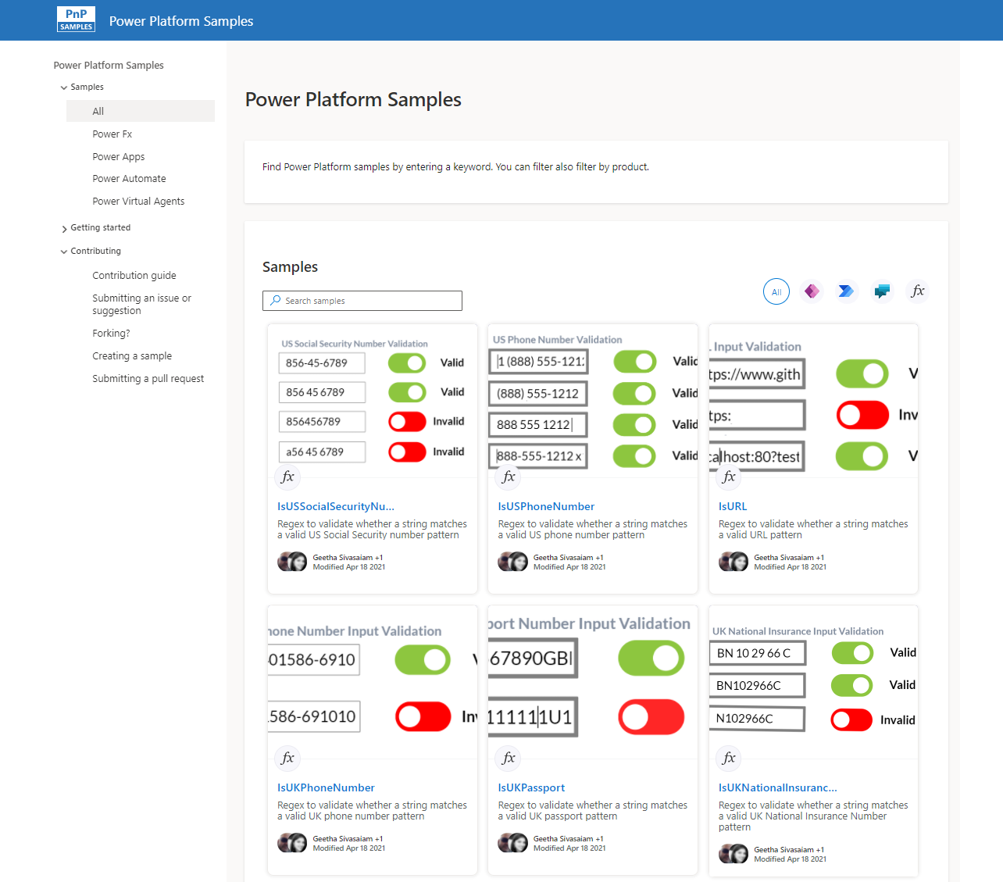
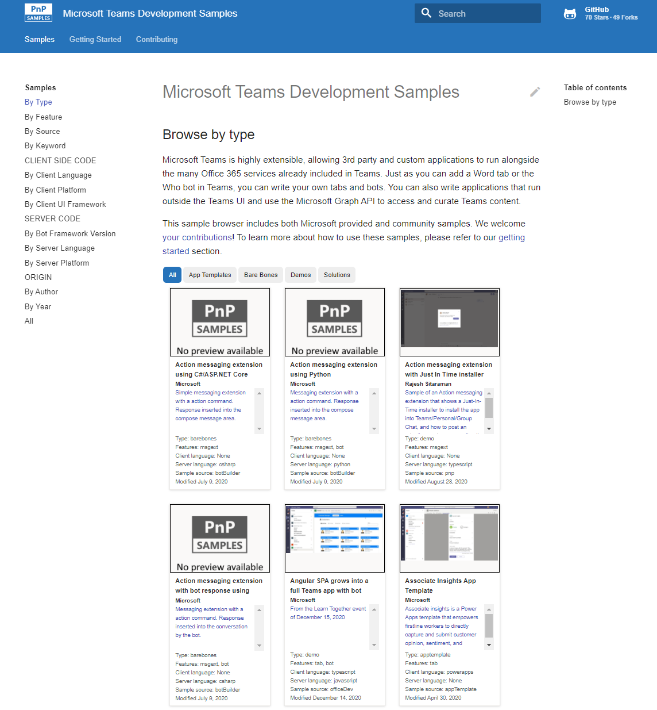
Microsoft 365 developer videos
Microsoft 365 community videos
Open-source
Sample galleries
Open-source initiatives and samples
github.com/sharepoint
github.com/pnp
github.com/officedev
github.com/microsoftgraph
aka.ms/m365/samples
aka.ms/teams-samples
aka.ms/spfx-webparts
aka.ms/powerplatform-samples
aka.ms/spfx-extensions
aka.ms/list-formatting
aka.ms/m365/community
aka.ms/m365devyoutube
aka.ms/m365pnp/videos
@Microsoft365Dev | @m365pnp

Slide 5
Microsoft 365 developer community calls
Microsoft 365 platform (weekly) https://aka.ms/m365-dev-call
(Notice. This call is on a summer break between July 1st and 31st of August 2022)
Adaptive Cards https://aka.ms/adaptivecardscommunitycall
Microsoft identity platform https://aka.ms/IDDevCommunityCalendar
Office Add-ins https://aka.ms/officeaddinscommunitycall
Power Platform https://aka.ms/PowerPlatformMonthlyCall
Microsoft 365 & Power Platform Development (bi-weekly) https://aka.ms/m365-dev-sig
Viva Connections & SharePoint Framework (bi-weekly) https://aka.ms/spdev-spfx-call
Download recurrent invites from
https://aka.ms/m365/calls
Notes:
m365-dev-sig

Slide 6







AGENDA
Latest news from Microsoft engineering on Microsoft 365 topics
Community together mode group photo
Rabeb Othmani - Introduction to Microsoft Graph Postman collection
Maisa Rissi - Microsoft Graph .Net SDK v5
Greg Taylor - Latest on deprecating basic auth for Exchange
Microsoft 365 platform call 14th of June @ 8 AM PT
Weekly call with Microsoft presenters covering the latest Microsoft 365 platform updates
Download recurrent invite from https://aka.ms/m365-dev-call
Notes:
Dan’s slide

Slide 7
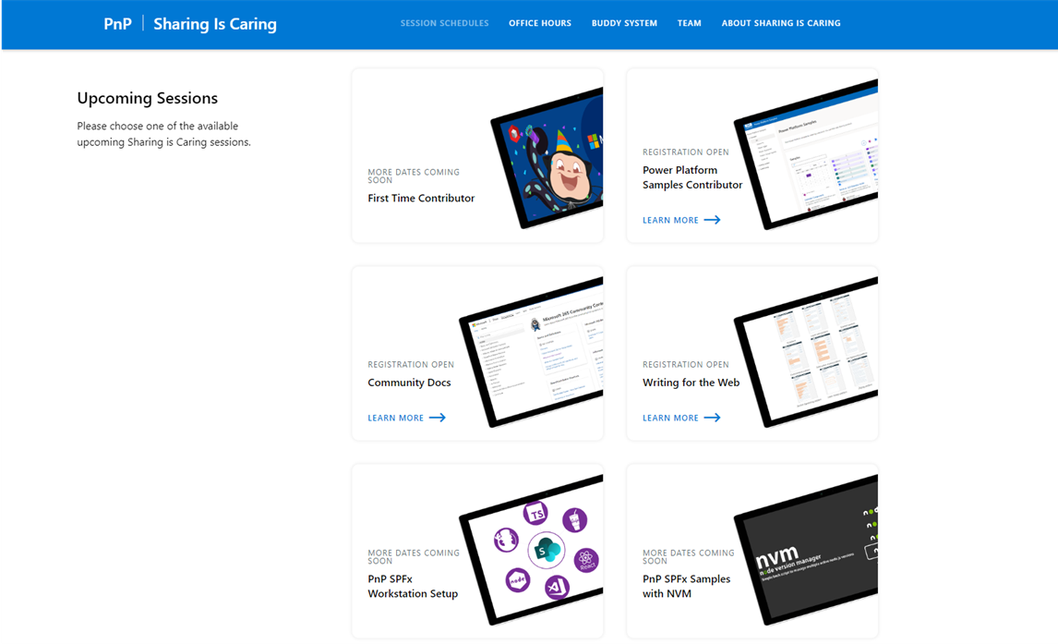
GUIDANCE
Learn how to get started in the open-source PnP community!
Upcoming Sessions:
First-time contributor
Power Platform Samples Contributor
Writing for the Web
Community Content Docs
SPFx Developer Workstation Setup
Using PnP SPFx samples w/ NVM
More than code with VS Code
First-time presenter
M365 Maturity Model Practitioners
Power Platform – Power Pages
COMING SOON
https://aka.ms/sharing-is-caring
Notes:
25 Total attendees, 16 attendees who attended both First-Time Contributors and Community Docs sessions.

Slide 8





COMMUNITY
PnP Recognition Program
Showcasing your contributions
Powered by Credly
More achievement levels coming soon
Notes:
25 Total attendees, 16 attendees who attended both First-Time Contributors and Community Docs sessions.

Slide 9
PnP .NET libraries A set of libraries that helps Microsoft 365 .NET developers to be more productive when working with SharePoint and Teams

Slide 10
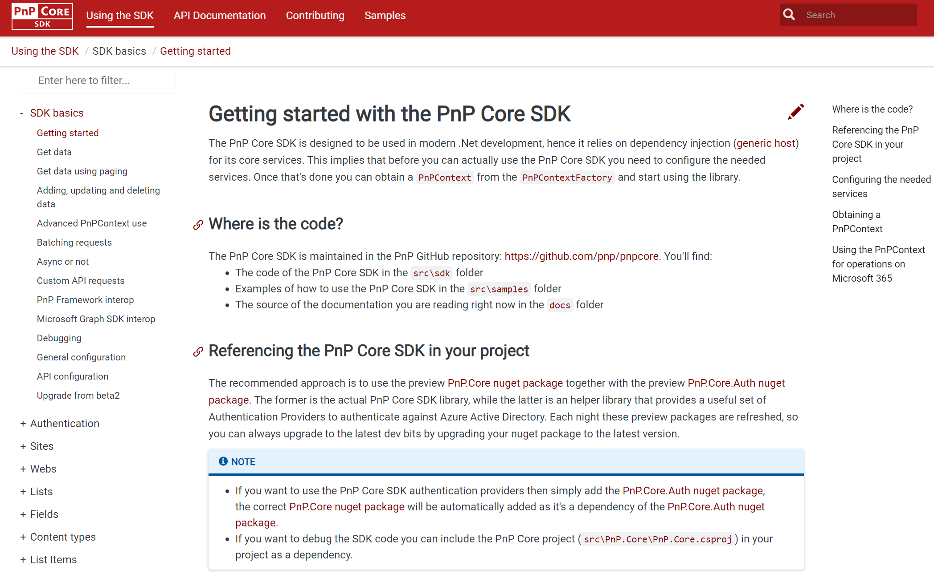
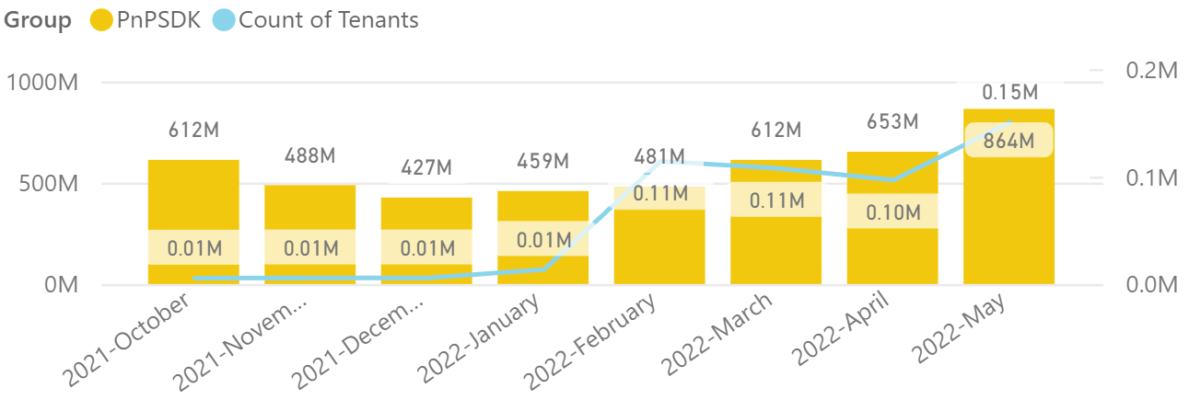
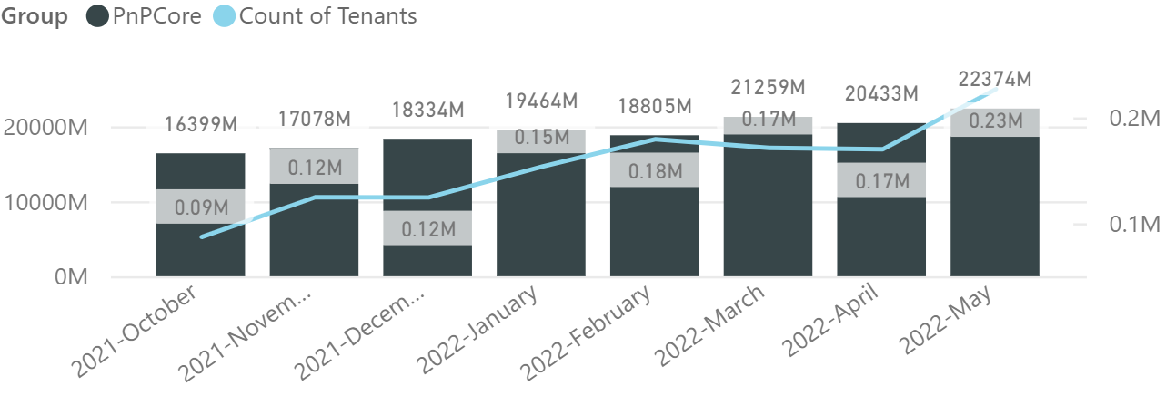

PnP .NET libraries
PnP Framework
PnP Core SDK
>220.000
tenants!
563,000 downloads!
Version 1.9.0 released!
Prepping 1.10.0 (end of June):
Merge pending PRs
General fixes and improvements: 👍 Miguel Angel García Martínez, Eduard Paul, Patrik Hellgren, Riccardo, Gautam Sheth, Daniel Pastoor and André Gouveia
758,000 downloads!
Version 1.6.0 released!
Prepping for 1.7.0 (end of June):
Creating and updating document sets, event receiver support on ISite : Mathijs Verbeeck 👍💪🚀
Support for group creation using application permissions: Daniel Pastoor 👍
Fixes and improvements: Daniel Pastoor, Bert Jansen 👍
Working on it
What key scenarios are still missing?
https://github.com/pnp/pnpcore/blob/dev/src/sdk/CHANGELOG.md
Roadmap
nuget.org/profiles/pnp
nuget.org/profiles/pnp
aka.ms/pnp/framework
aka.ms/pnp/coresdk

Slide 11
PnP PowerShell Open-source cmdlets which provide you an easy way to manage your SharePoint and Teams environment.

Slide 12
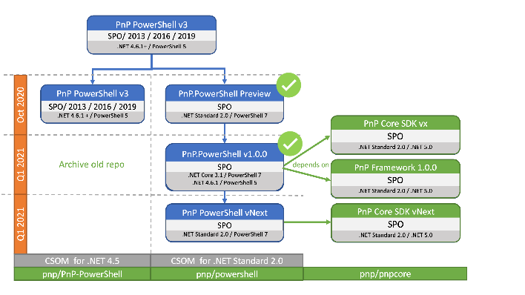
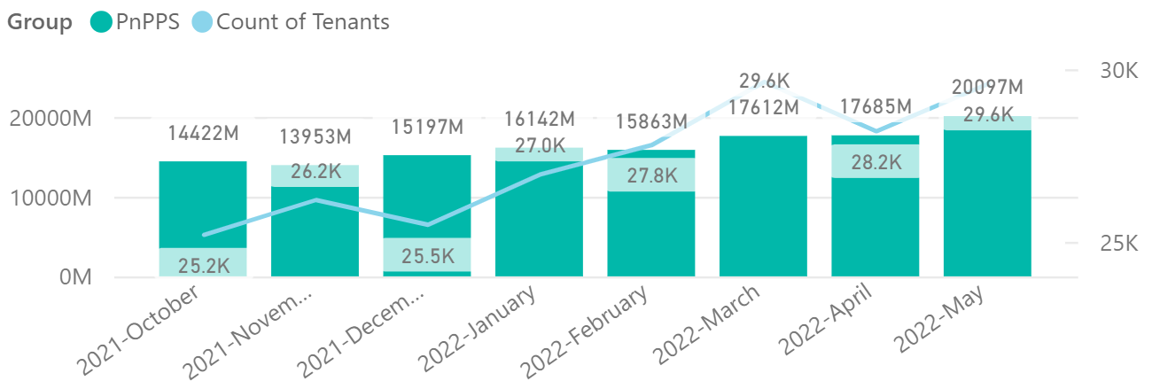

PnP PowerShell
Cross Platform PnP PowerShell
V1.10.0 released!
Many updates and fixes!
2.2 million downloads!
100 million cmdlets executed per day!!
Docs shifted, no more docs.microsoft.com
Documentation, Articles and tips available at https://pnp.github.io/powershell
PnP PS runs in PS 5, PS 7, Azure CloudShell, Azure Functions, Azure Runbooks & Raspberry Pi
Bug Fixes
Added Restart-PnPFlowRun added to allow failed run to be retried.
Added Get-PnPListItemPermission to retreive item level permissions.
Get-PnPTerm now also returns deprecated terms if specified.
Improvements to Connect-PnPOnline, allows better switching, validation and storing of the connection objects
Bug fixes and improvements continue to 1.11 release.
What next ? Would love to hear your thoughts !
>29.500 tenants!
Working on it
https://github.com/pnp/powershell/blob/dev/CHANGELOG.md
github.com/pnp/powershell
www.powershellgallery.com
PnP.PowerShell

Slide 13
yo teams Open-source Yeoman generator for Microsoft Teams development

Slide 14
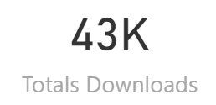
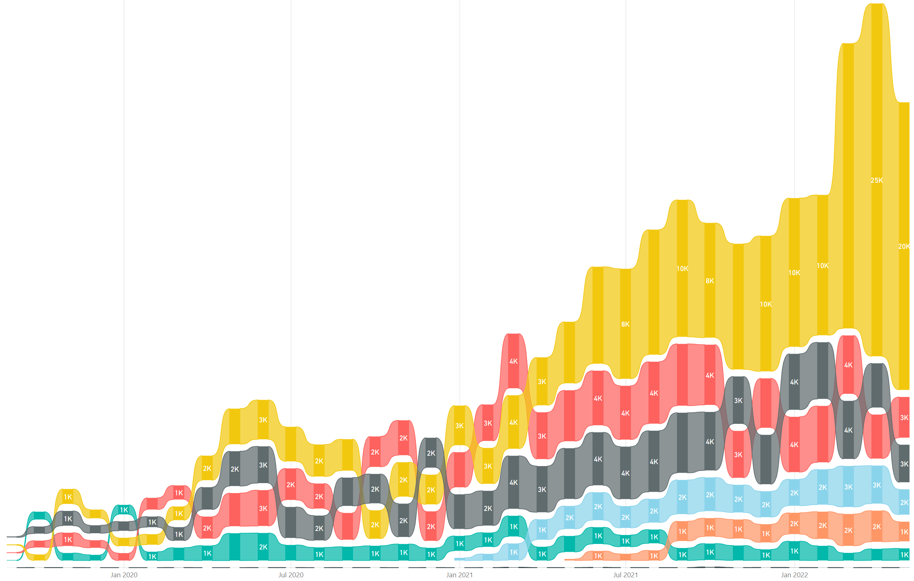
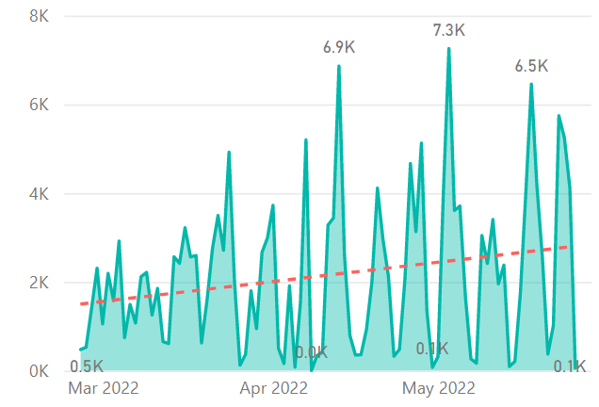
yo teams
https://aka.ms/yoteams
generator-teams – The Teams apps generator
Package Downloads
📃 Docs published at https://pnp.github.io/generator-teams/
🚀 Latest release: 3.5.0 [2021-11-18]
Improved telemetry (https://pnp.github.io/generator-teams/about/telemetry/) Brand new template used for bot scaffolding – better aligned with Bot Fx code samples
🔮 Preview: 4.0.0-preview.3 [2022-05-23]
Using @microsoft/teams-js version 2.0 (promise based) Support for the m365DevPreview manifest (Deprecation of scaffolding options for v4 · Discussion #304 · pnp/generator-teams (github.com)) Allows you to build Tabs for Outlook and Office.com
📅 Roadmap:
4.0.0 GA release for //Build
Version 4.0 is imminent – pending an issue with the new Teams JS SDK
yoteams-build-core
yoteams-deploy
Daily build events
🚀 Latest release: 1.6.0 [2022-02-17]
PR #278, from Paul Schaeflein, with additional gulp-inject options Support for schema m365DevPreview and 1.12
🔮 Preview: 1.7.0-preview.3 [2022-05-23]
Support for the m365DevPreview manifest Fixed telemetry bug 📅 Roadmap: n/a
🚀 Latest release: 1.1.0 [2021-11-18]
Telemetry for tasks
🔮 Preview: : 1.2.0-preview.2 [2022-05-12]
Dependency updates
📅 Roadmap:
n/a

Slide 15
Microsoft Graph Toolkit Web Components powered by Microsoft Graph

Slide 16

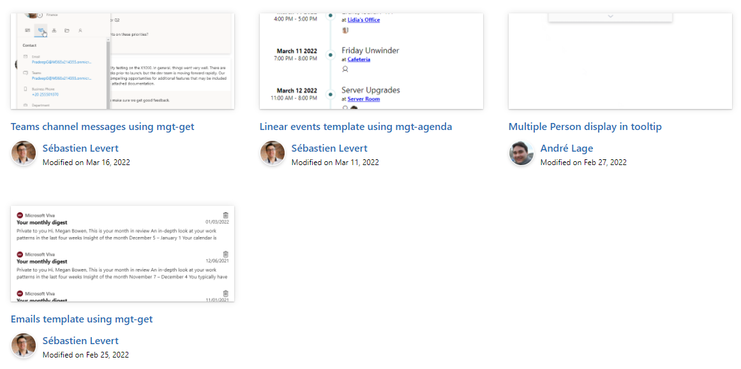

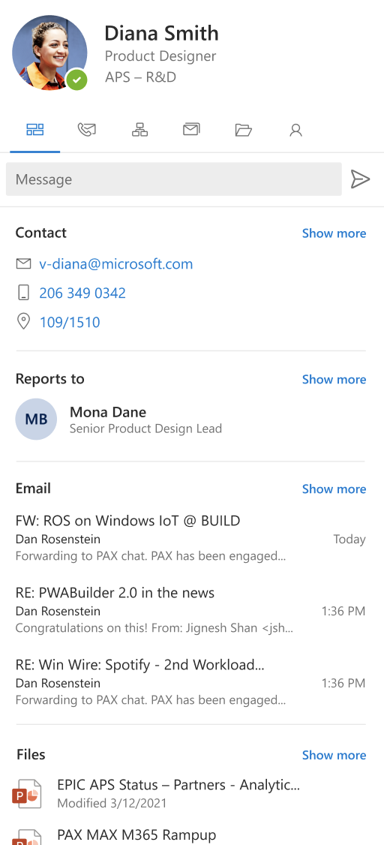
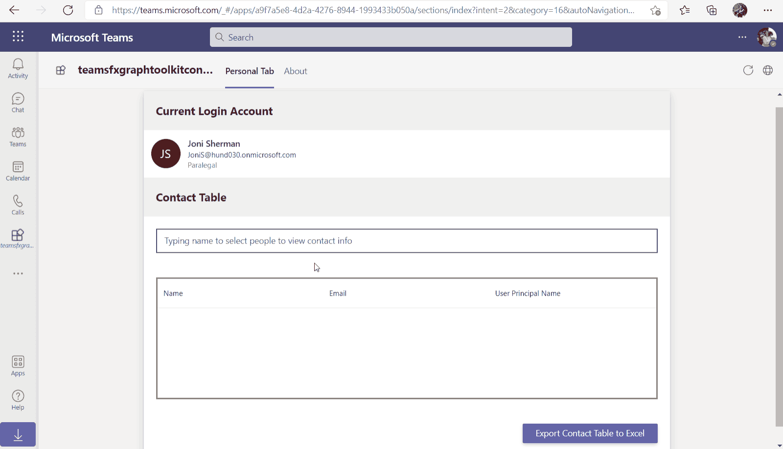
Microsoft Graph Toolkit
👀 More information: aka.ms/mgt
What’s new 🎉
The MGT samples repository is now LIVE! https://aka.ms/mgt/samples
v2.5.2 was released! Update your packages! https://aka.ms/mgt/v2.5.2
Updates to our Msal2 and Teams providers
GA release of our TeamsFx provider
Thanks @jocsch, @stniemin and @estruyf for your contributions 🎉
Our playground is now a PWA! Have a look https://aka.ms/mgt/dev
What's next? 💻
Aligning all Toolkit components to Fluent UI Web Components
More generic components and theming capabilities
We need your help ❤️
🐞 Help us fix bugs
🆕 Help us build/improve features
help-wanted & good-first-issue -> https://aka.ms/mgt/issues

Slide 17

Independent Publisher Connectors
What’s new
48 Awesome Independent Publishers!
132 Independent Publisher connectors!
4 New connectors:
Jay Jani- MS Graph Groups and Users
Mitanshu Garg- RegEx Matching
Troy Taylor- Meme
Troy Taylor- Unofficial Netflix Search
1 Update to existing connectors:
Woong Choi- GoQR (originally built by Rui Santos)
We need your help
Become an Independent Publisher by building one of these connectors: Top Connector Asks · microsoft/PowerPlatformConnectors Wiki (github.com)
Attend the next Power Platform LABs call on June 29 at 11am ET at aka.ms/PowerPlatformIntegrationLABs.
Welcome to the Community that will fuel and empower your dream towards building integration solutions! From key connector topics, such as implementing webhook triggers, to gateways- our goal is to learn together, ask questions, & provide the tools and knowledge needed to build your next integration to the Power Platform.

Slide 18
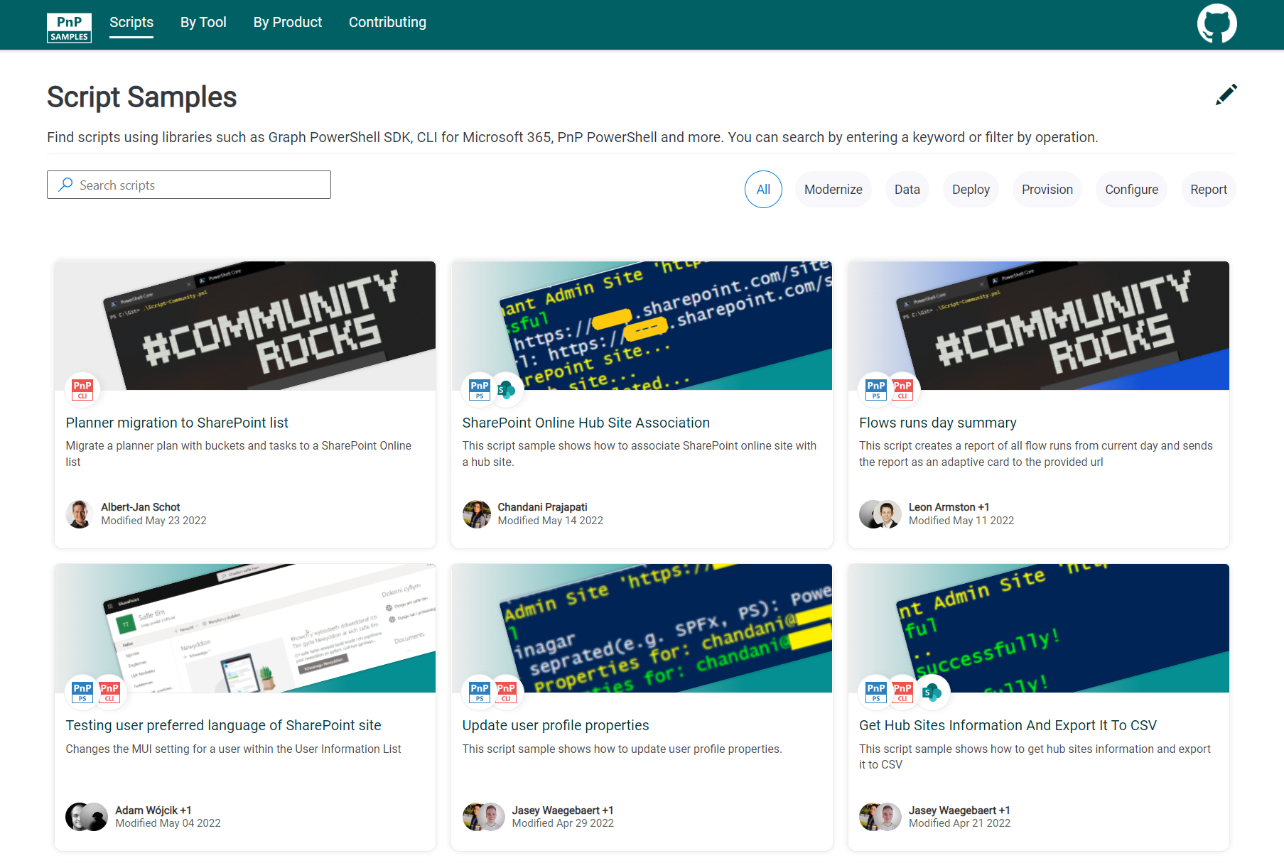

SCRIPT SAMPLES
One centralized location for all scripts for helping your day-to-day life. Contribution's welcome!
Site now has 152 scenarios and 228 scripts, using Microsoft Graph, CLI for Microsoft 365, PnP PowerShell, SPO Management Shell tooling and more…😁 AND samples integrated into "Unified" Solution Gallery
Samples Include (Bumper Edition 🤩)
New scenarios using CLI for Microsoft
Copy planner plan by Milan Holemans
Updated Scenarios with CLI for Microsoft 365 Scripts
Fetch User Profile Properties from Site Collection and export to CSV by Mathijs Verbeeck
SharePoint Online Hub Site Association by Jasey Waegebaert
Get SharePoint List or Library Permissions and export to CSV by Nanddeep Nachan
Reset files permissions unique to inheritance by Nanddeep Nachan
Script allow copy column format in SharePoint and appl to different column by Jasey Waegebaert
Bulk Library generation by Milan Holemans
Run a search query and export to CSV by Smita Nachan
Updated Scenarios with PnP PowerShell Scripts
Planner migration to SharePoint List by Reshmee Auckloo
We have good first issue in the GitHub Repo with sample ideas of scripts you could write – thank you Adam Wójcik! https://github.com/pnp/script-samples
Thank you for your samples and contributions! 👏
good first issue
aka.ms/script-samples

Slide 19

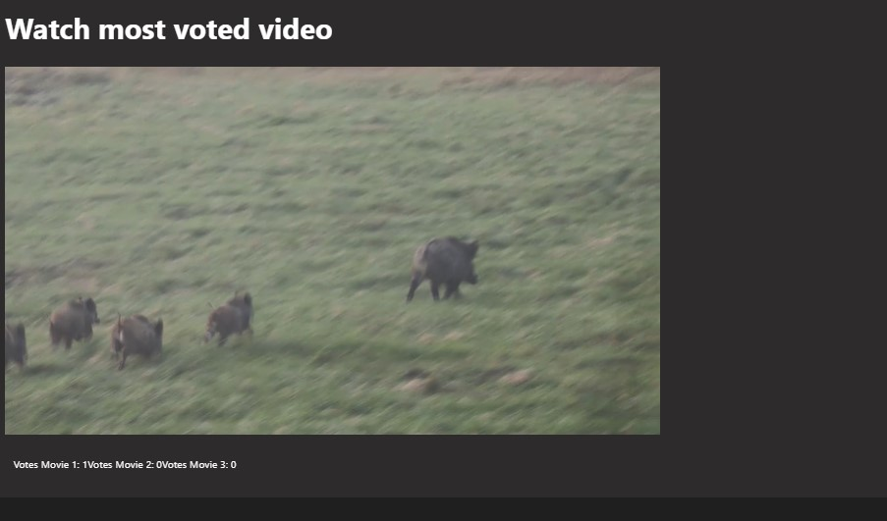
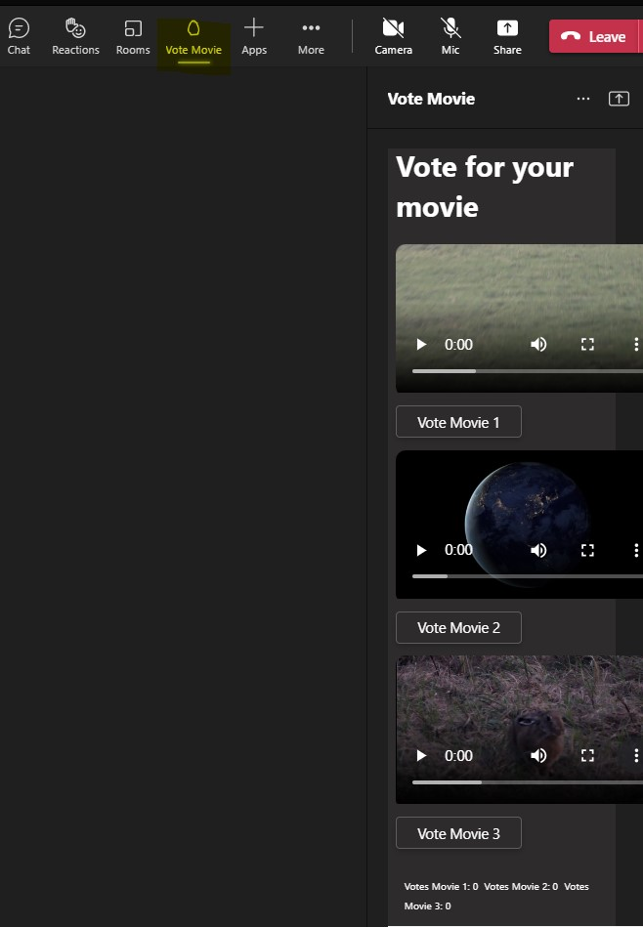
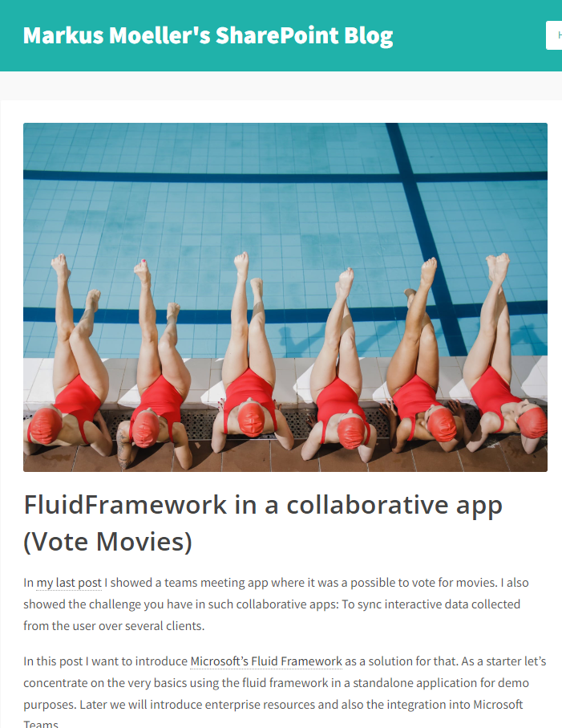








Microsoft Teams Samples
Watch and vote for movies in a Teams meeting!
Meeting app with sidebar and stage view
Vote and watch movies together
Uses Fluid Framework
Detailed blog article https://mmsharepoint.wordpress.com/
SAMPLES WANTED!
https://aka.ms/tab-meeting-stageview-vote-movie
Many thanks to Markus Moeller (@Moeller2_0) for yet another amazing sample!
Check out all the samples! https://aka.ms/m365-samples
Teams samples w/filtering https://aka.ms/teams-samples
Got a cool Teams app to share?
Please contribute – or make use of the samples yourself!
All the samples are at https://aka.ms/m365-samples
Teams samples w/filtering https://aka.ms/teams-samples
Notes:
Wajeed Shaikh – Teams PM

Slide 20

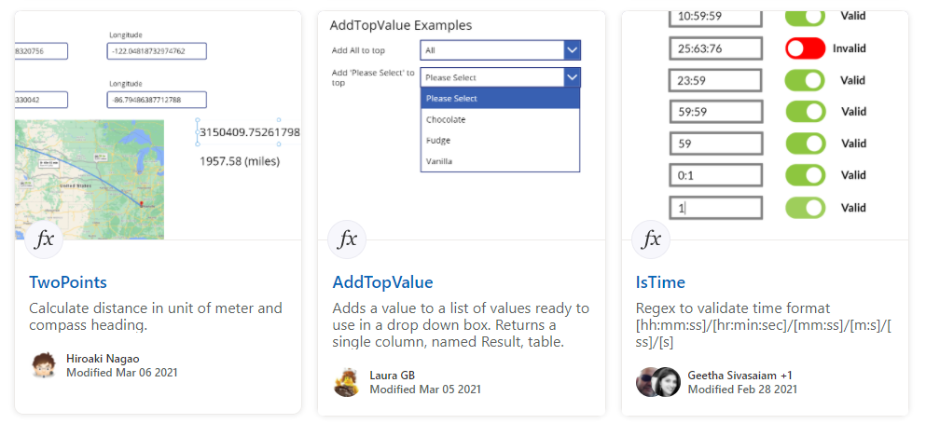
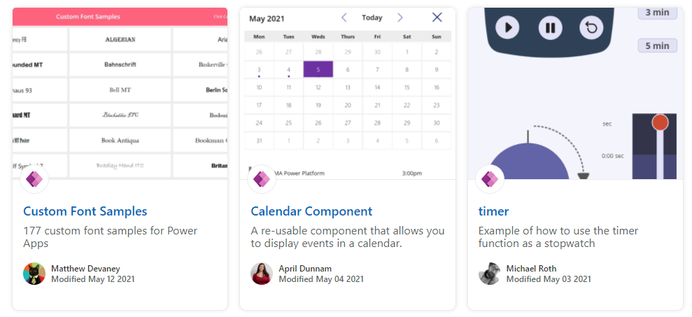
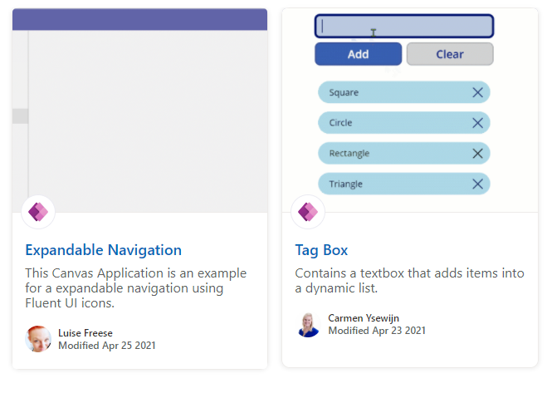
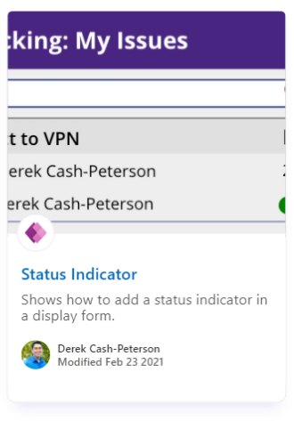
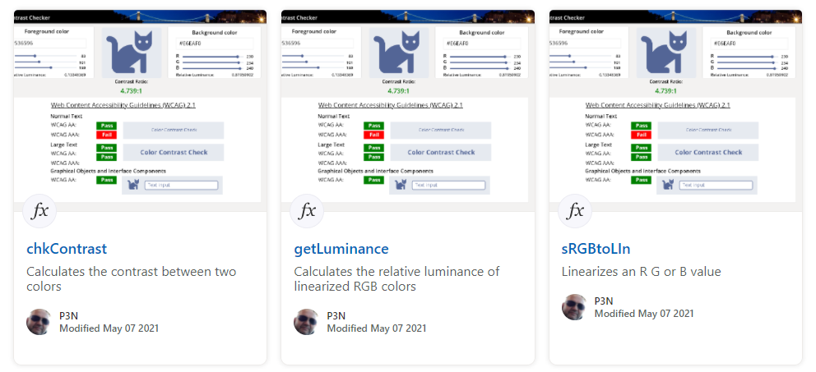
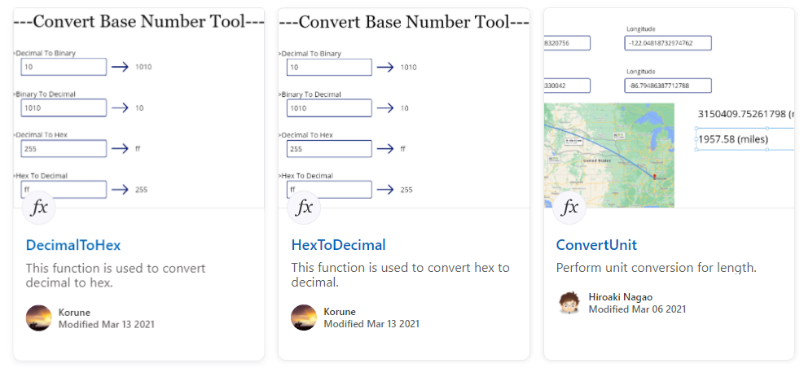
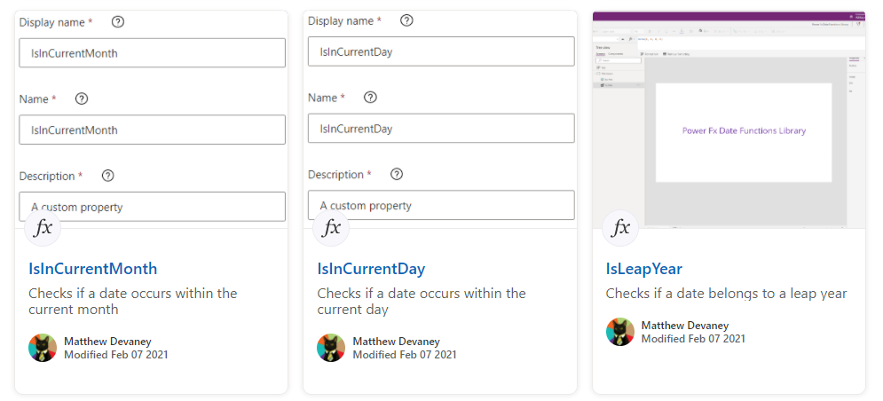
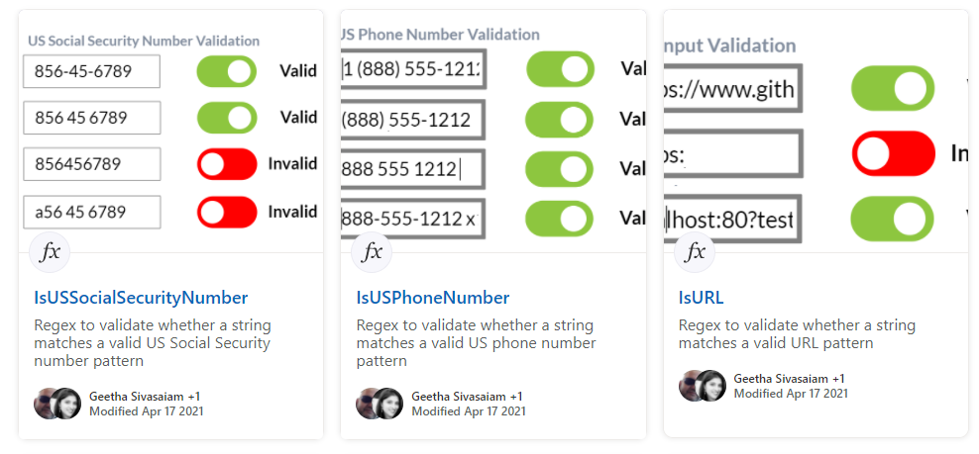
Power Platform Samples
aka.ms/powerplatform-samples ​
Power Apps templates​
Power Apps components​
Power Apps connectors​
Power Fx Custom Functions
Power Automate flow templates​​
PowerBI​​
Power Virtual Agents​​
Join the Power Platform Contributors
Sharing is Caring Session – Wednesday June 29th

Slide 21
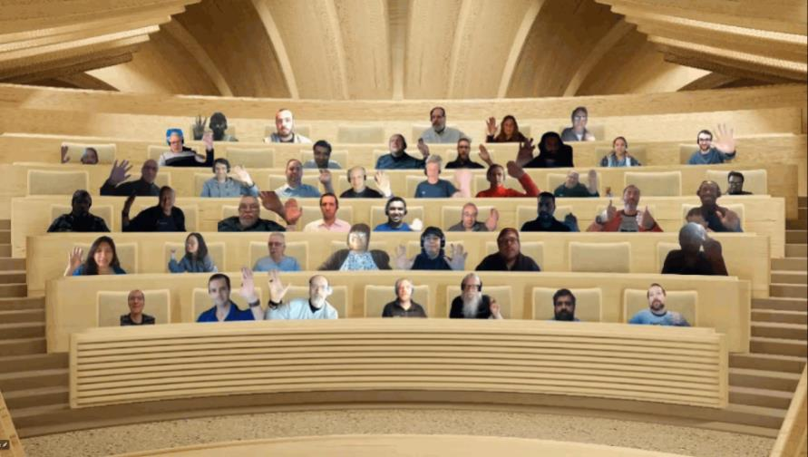

Optional picture time!
Video on and we’ll grab a Together Mode pic with those who are willing to do this.
We are together on this as a community!
By enabling your camera for the picture, you’ll give us the permission to share your picture in social media.

Slide 22
DEMO
Independent Publishing Connectors Sessionize Demo
– Nanddeep Nachan
– Smita Nachan
List Formatting - Payment Registration
– André Lage
Understanding Sites.Selected permissions in SharePoint Online
– Paolo Pialorsi

Slide 23
Thank you
Recording will be available in 24 hours on
Microsoft 365 Community (PnP) YouTube channel
https://aka.ms/m365/videos
(subscribe today)
Follow us on Twitter
@Microsoft365Dev | @M365PnP
Next M365 General Dev call: June 23rd at 07:00am PT
Next Viva Connections & SharePoint Framework call: June 16th at 07:00am PT
See all other community calls from https://aka.ms/m365/community

Slide 24



Slide 25
Thank you

